Slide 1

Internship Presentation (Quantitative and qualitative analysis)
Submitted by:
Virender Singh
National Institute of Technology,
Hamirpur (H.P.)
Mentored by:
Fahim Mohammad
Sai Teja Vallabhaneni

Slide 2
Contents
Internship Goal
Recommendations based on the benchmarking done by comparing Saint Gobain home website and some Indian and International websites.
Data Analytics Part
Maharashtra region
Andhra Pradesh region
Recommendations to improve sales
My Internship learnings

Slide 3
Internship Goal
To find out what are the various problems that an individual can face with windows.
To understand how the UPVC windows and UPVC profiles are manufactured in the plant
To do complete benchmarking on Saint Gobain Windows Home website and some Indian and International Windows websites and to find out the ways how to improve the Saint Gobain windows home website.
To collect Sales data related to the various opportunities raised by the sales team of Saint Gobain , analysis the data and provide regional insights that will help to increase customer reach and sales

Slide 4
Recommendations to improve Saint Gobain Windows Home website
Provision for finding the dealer and or contractor nearby the locality
(AIS windows and Jeld Wen websites are having this feature).
Feedback provision for the customers. It helps to understand the customer’s experience with the product or service. It also helps the marketing team to understand where there is a gap for improvement(Jeld Wen website is having this feature).
Searching provision to find the right product. It helps the customer to find the product easily and in less time.(Fenesta , Anderson , pella Jeld Wen websites are having this feature)
Transportation cost estimator based on the project location.(No website is having this feature.)
Recent customer’s Project review and testimonials so that the new customer can get some ideas for his/her project work and testimonials helps to push the customers to buy products or services(AIS windows, Anderson windows and pella windows are having this feature.)
Product buying and installation guide.(No website is having this feature)
GitHub Link for Benchmarking: https://github.com/virender-7728/Saint-Gobain-Intership-files

Slide 5

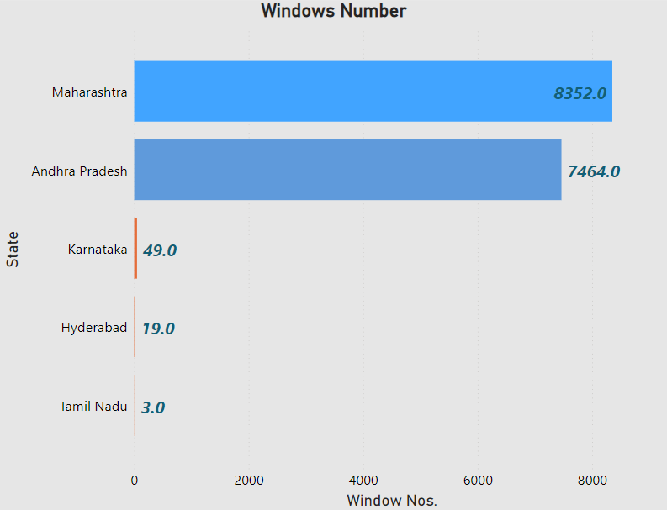
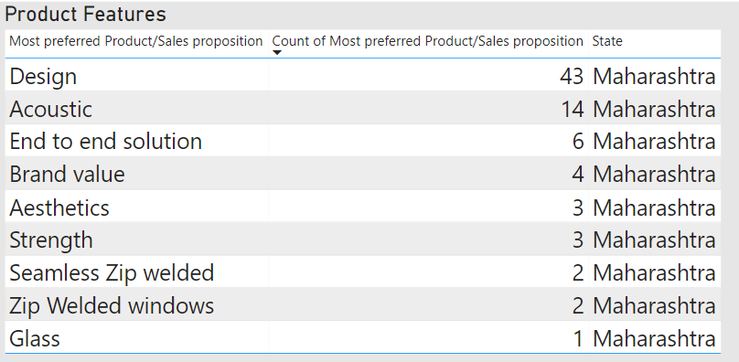
Data Analytics Part Maharashtra Region
Windows number
Preferred product Features

Slide 6
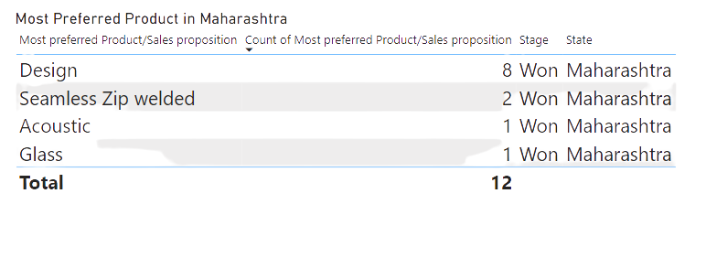
What type of product features we are able to won most in Maharashtra region
Product won %age
Design = 18.61%
Seamless Zip welded = 50%
Acoustic = 7.14%
Glass = 100%

Slide 7
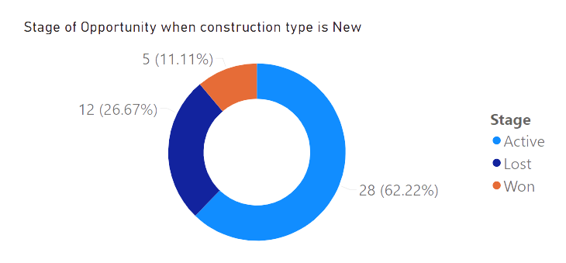
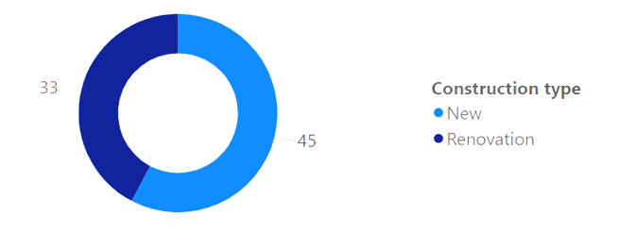
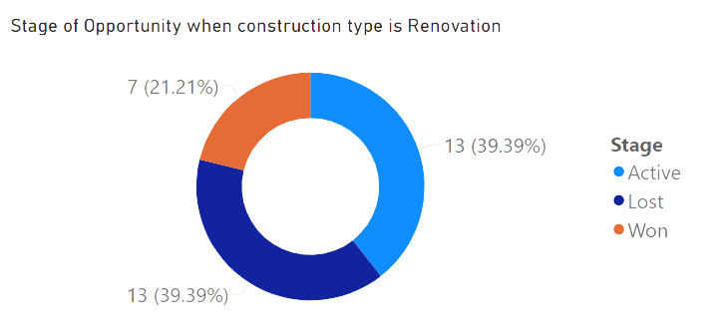
Analysis based on Construction Type
More opportunities are won when the construction type is Renovation

Slide 8
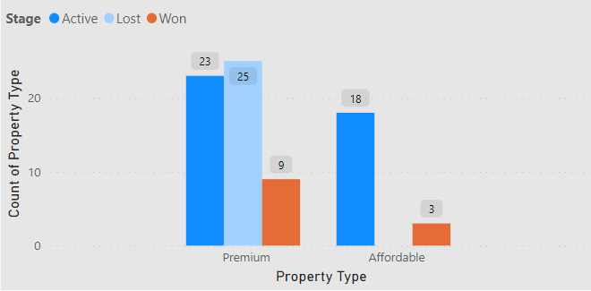
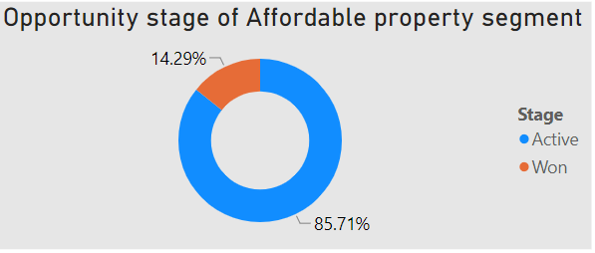
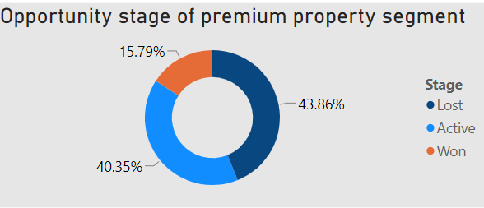
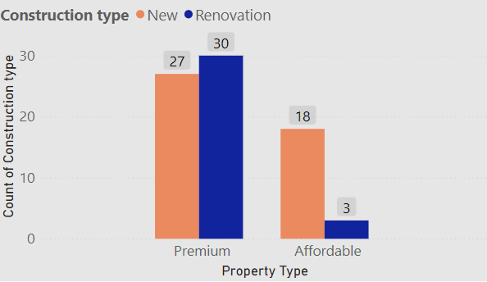
Analysis based on property segment
Won %age in premium segment is more than the affordable segment.
In affordable segment we are getting only few renovation type projects.

Slide 9
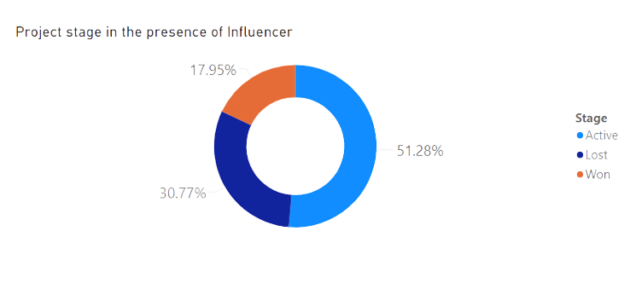
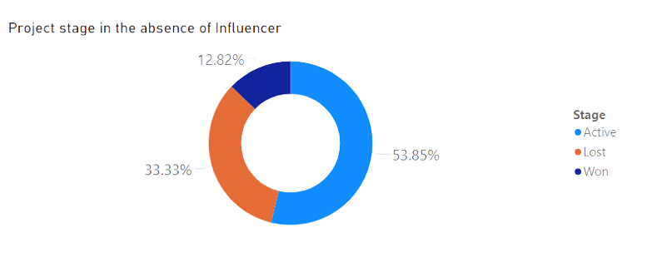
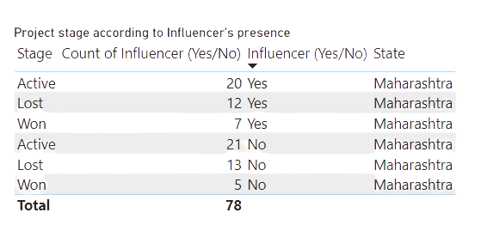
Effect of Influencers on the sales in Maharashtra region
Won %age in presence of influencer = 17.95%
Loss %age in presence of influencer = 30.775%
Won %age in absence of influencer = 12.82%
Loss %age in absence of influencer = 33.33%

Slide 10
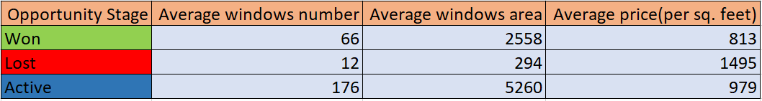
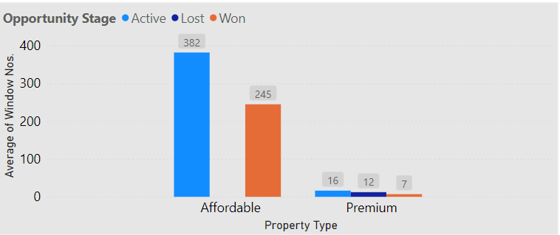
Analysis based on Window Area and Price in Maharashtra region
In affordable segment the opportunities won have average windows number(245) much greater than premium segment(7)
Opportunities having very less number of windows and Area are lost.

Slide 11
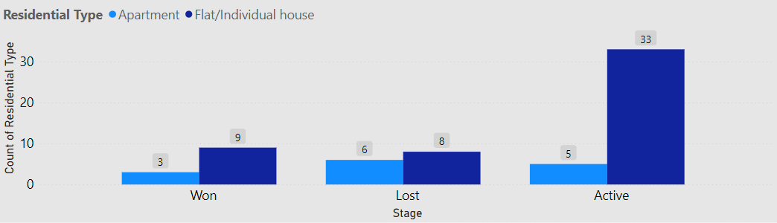
Andhra Pradesh region
Aanalysis based on residential type
In Andhra Pradesh Flat/Individual houses Type of Opportunities are more than the Apartment type
Number of opportunities won in Flat/Individual Type are more than the Apartment type

Slide 12
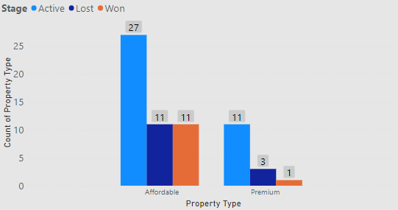
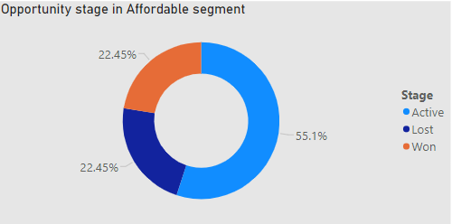
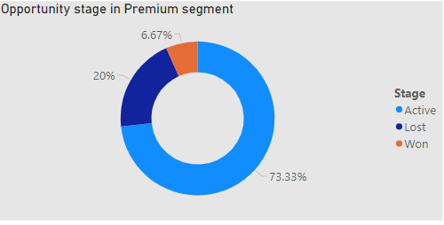

Analysis based on property segment
More opportunities are won in Affordable segment
In premium segment opportunities having more price(per sq feet) for less area, are lost.

Slide 13
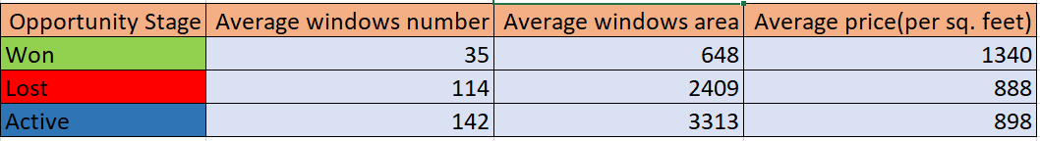
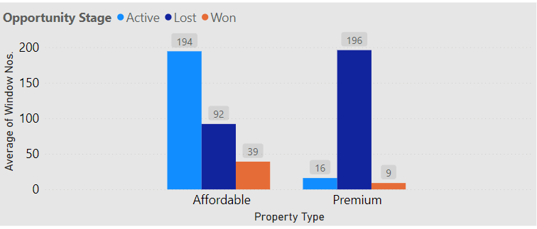
Analysis based on Window Area and Price in Andhra Pradesh region
Opportunities having less number of windows and less window area are won while opportunities with more number of windows and more window area are either lost or in Active stage.

Slide 14
Recommendations to improve sales
In Maharashtra region influencers plays a vital role as we have seen in the presentation. So we can involve more influencers to increase the sales.
In Maharashtra, renovation type opportunities are less but their won percentage is high. So to improve the sales, we should need to get more renovation type work.
Opportunities with less number of windows we have lost due to high construction cost per sq feet.

Slide 15
My internship learnings
How UPVC windows and UPVC profiles and How are they manufactured.
Improve websites by doing a detailed benchmarking with the competitors.
Collecting data from the sales team and then analysis data using some powerful business tools like Microsoft Power Bi.
How to work as a team and find solutions to the problems that arises during the work.
Obtaining insights that helps to increase reach and sales of the products.

Slide 16
THANK YOU!

